Slide 1
Recommender Systems
By Christopher Brossman
2017-05-16

Slide 2
contents
Recommender Overview
Recommender lab in R
Example using behavioral data instead of rating data
Recommenders were designed for rating data, but most data isn't rated.
It can be extended to behavioral data – views, transactions, etc.

Slide 3
What is a recommender system
Recommendation engines, a branch of information retrieval and artificial intelligence, are powerful tools and techniques to analyze huge volumes of data, especially product information and user information, and then provide relevant suggestions based on data mining approaches
Types
Collaborative filtering
Content based
Hybrid
Context-aware
Probably more – new advances every day
Some useful tools for recommender systems – some examples of each in repo!
R
Python
Spark
Neo4j

Slide 4
Collaborative filtering
Basic form of recommender systems, by filtering items from a large set of alternatives is done collaboratively by users’ preferences
Assumes…
If two users share the same interests in past, this will continue in future
Types
User based
Calculate similarity matrix between all users. Recommend new items to an active user based on the rating given by similar users on the items not rated by the active user
Item based
Calculate similarity matrix between all items. Find the top similar items to the non-rated items by active user and recommend them.
ALS (alternating least squares)
Used in distributed systems. Estimate matrix factorization of user-item matrix into a user matrix and item matrix with latent factors

Slide 5
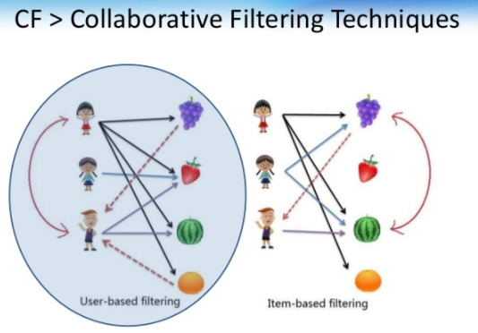
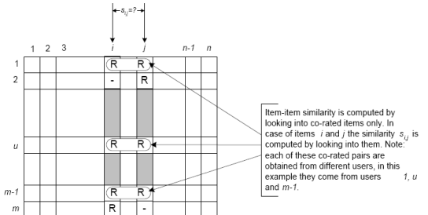
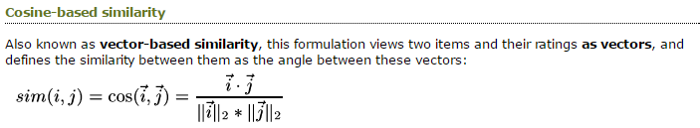

collaborative filtering – user/item

Slide 6
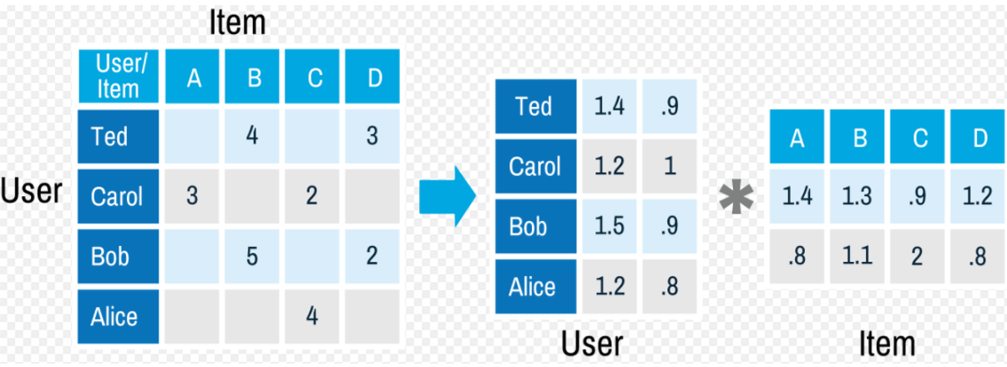
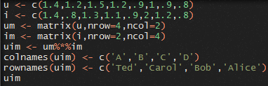

Collaborative filtering - als

Slide 7
Recommender in r
recommenderlab: A Framework for Developing and Testing Recommendation Algorithms
recommenderlab is implemented using formal classes in the S4 class system.
R has three object oriented (OO) systems: [[S3]], [[S4]] and [[R5]]. This page describes S4.
Compared to S3, the S4 object system is much stricter, and much closer to other OO systems. There are two major differences from S3:
formal class definitions: unlike S3, S4 formally defines the representation and inheritance for each class
multiple dispatch: the generic function can be dispatched to a method based on the class of any number of argument, not just one
They use “slots” accessed via “@” symbol. Similar to named lists accessed via “$”

Slide 8
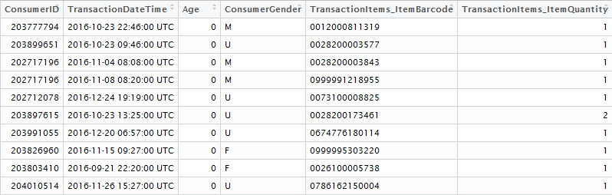
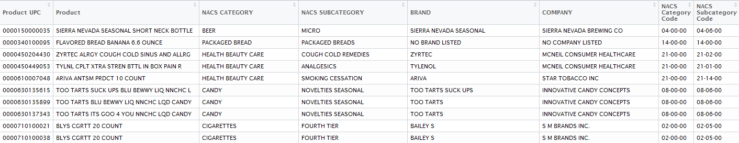
Example using store transactions
Transactions: 464,047 rows
Attributes of products: 28,528 rows

Slide 9
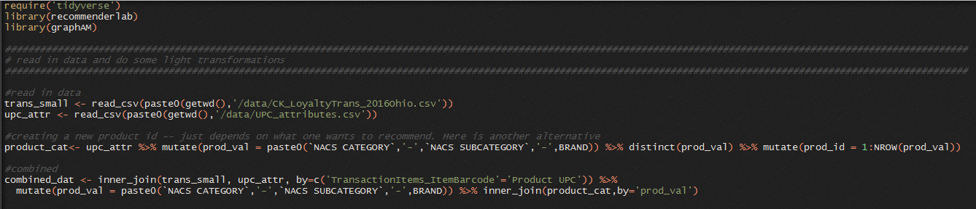
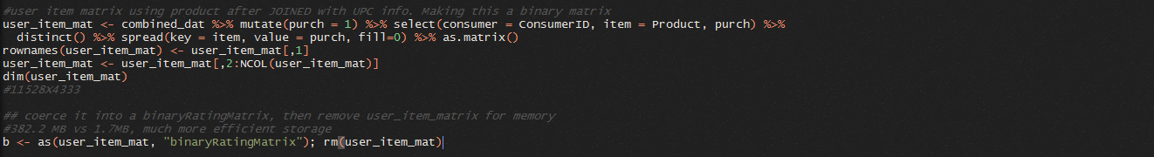
prep data – create binary matrix

Slide 10
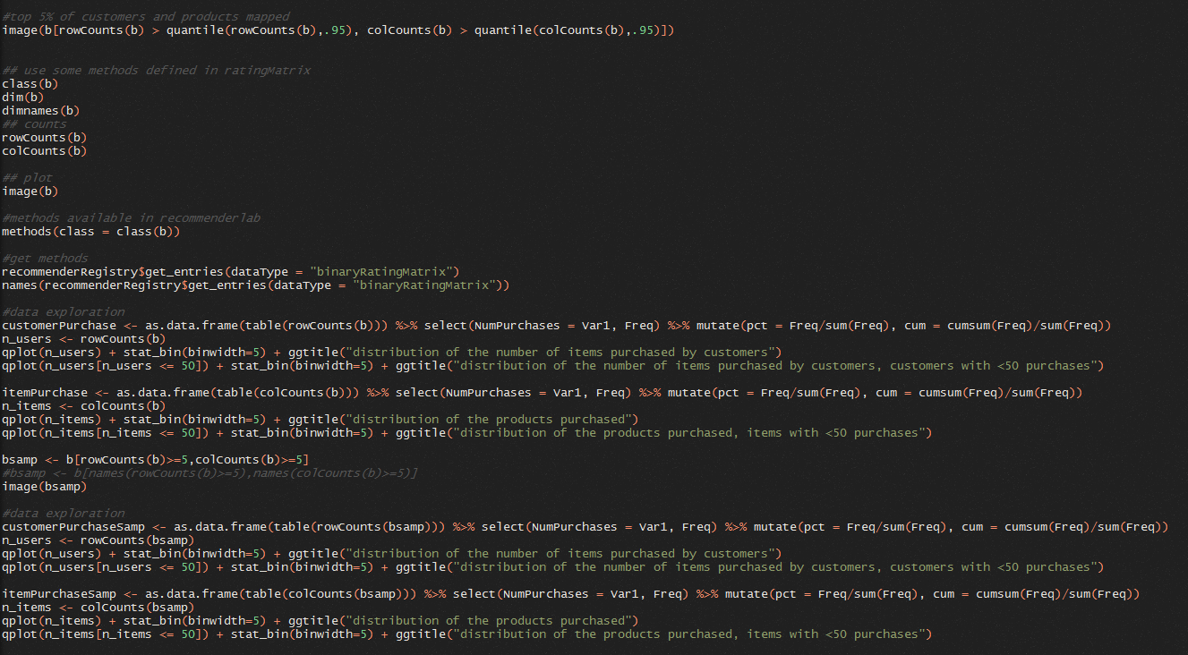
Examine data

Slide 11
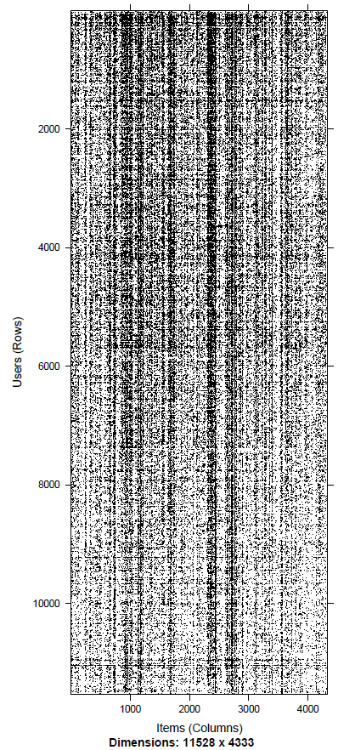
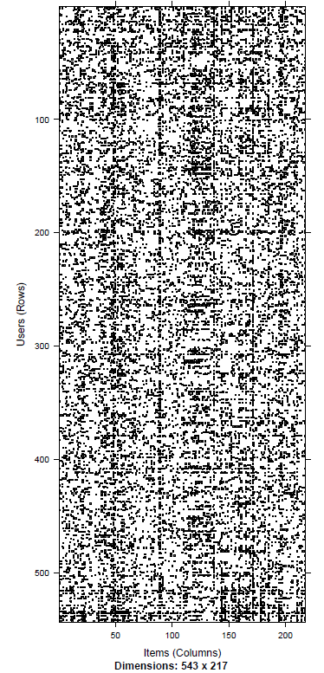
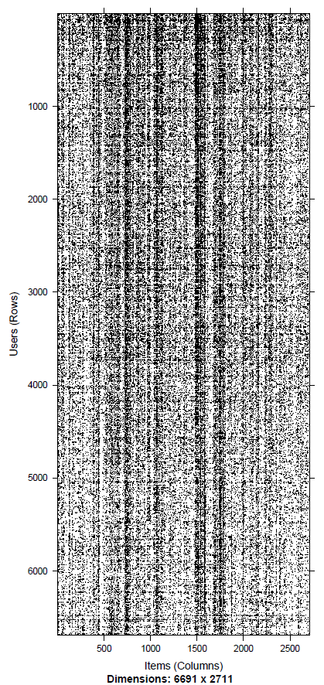
Sparsity of matrix – highly sparse
All Data
Top 5% Customer/Product
Customer/Product >=5 interactions

Slide 12
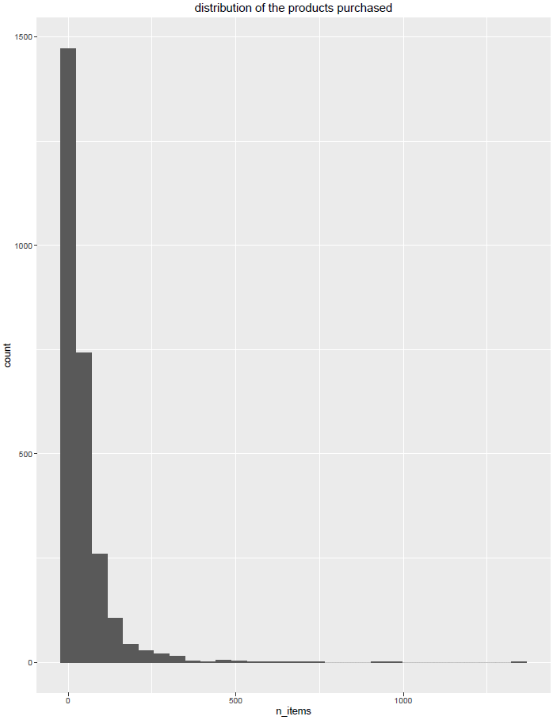
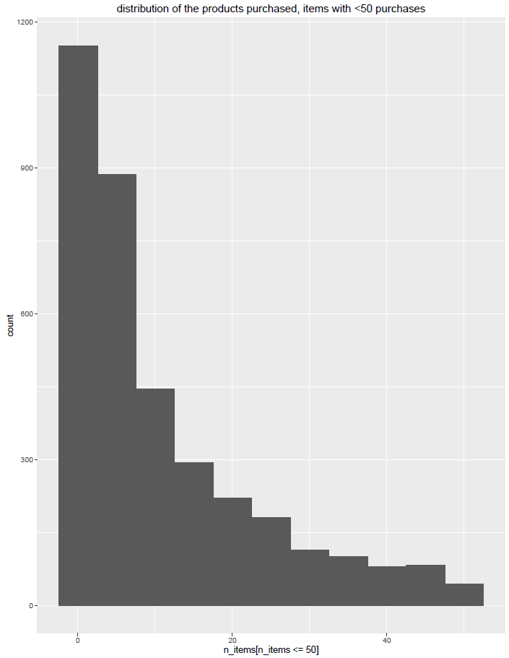
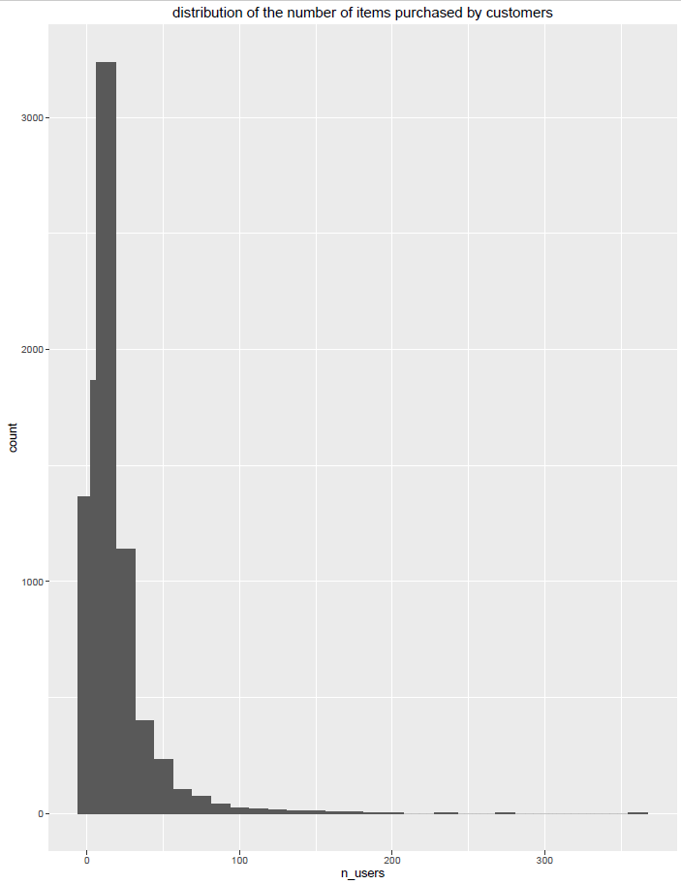
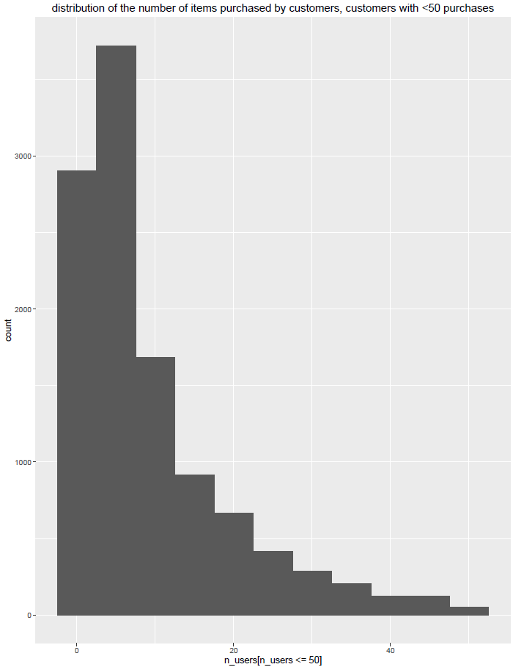
transactions per customer/Product

Slide 13
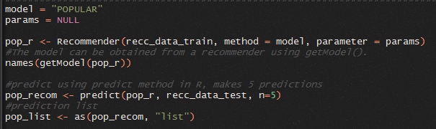
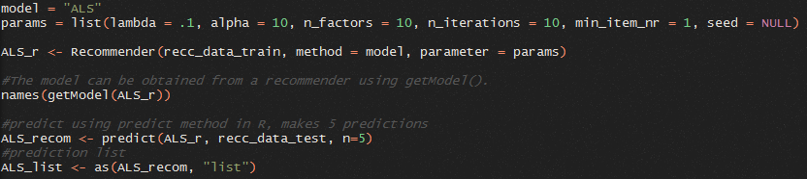
Create models

Slide 14
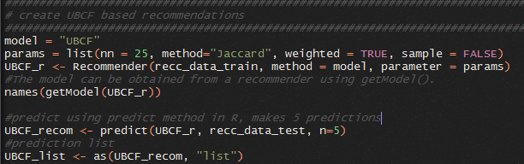

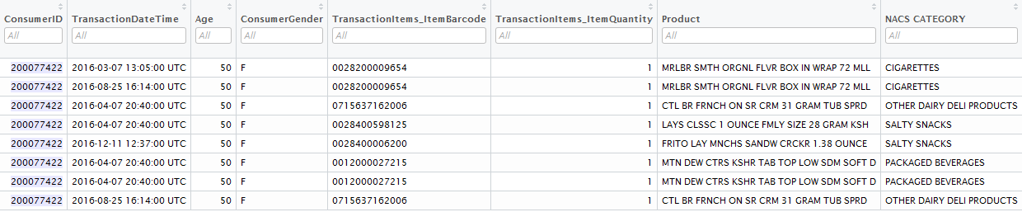
Prediction/history of purchases
Build UBCF model and make predictions
Top 5 product rec. for customer #200077422
Historic purchases of customer #200077422

Slide 15
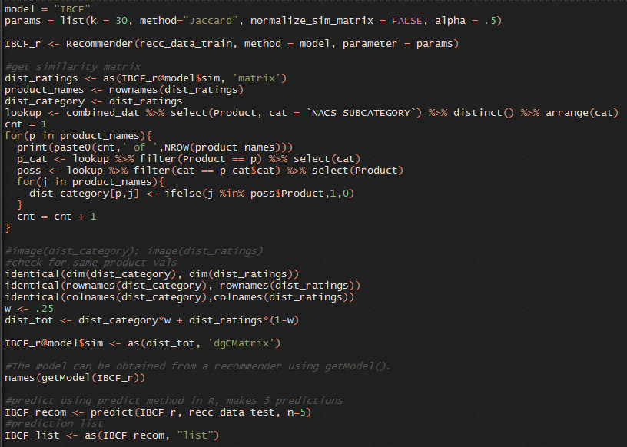
Hybrid model - ibcf
IBCF creates similarity matrix between all products.
We can integrate other dimensional information about products as long as they conform to the same matrix dimensions
Here we create a binary matrix if two products are in the same product category
Then integrate this information in the similarity matrix

Slide 16
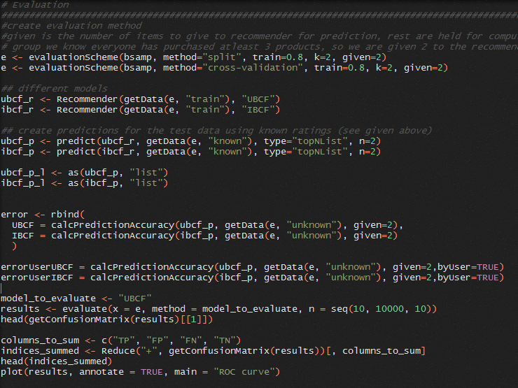
Evaluate model
Evaluation scheme handles split or cross validation
New models are created here due to evaluation scheme, although earlier models could be modified to this format.
Can create grid using “evaluate” to determine optimal params
Can obtain confusion matrix using code below

Slide 17

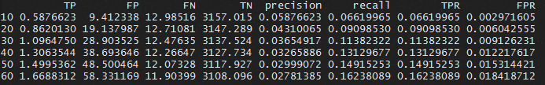
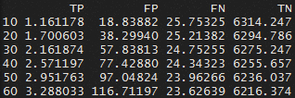
Evaluate model

Slide 18
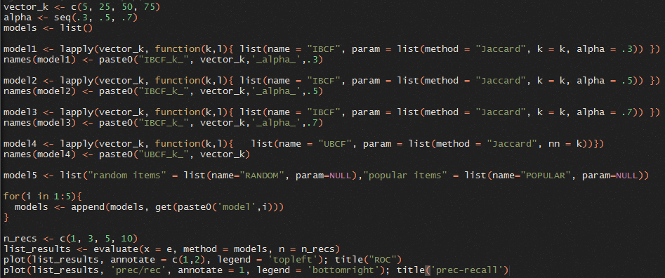
grid search to optimize parameters

Slide 19
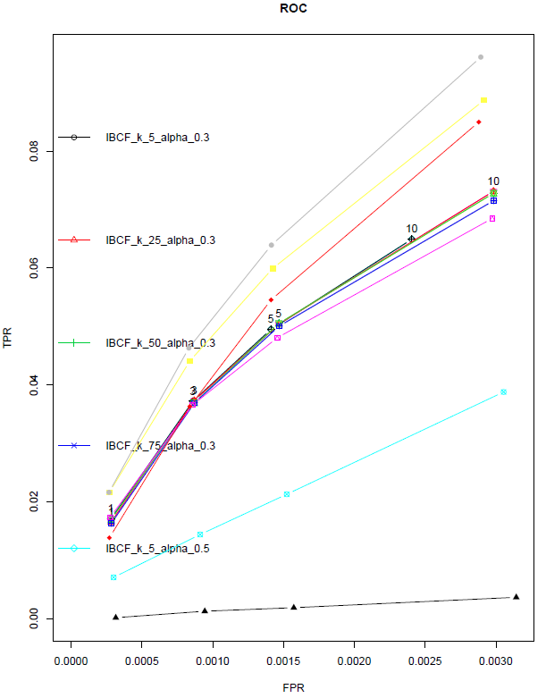
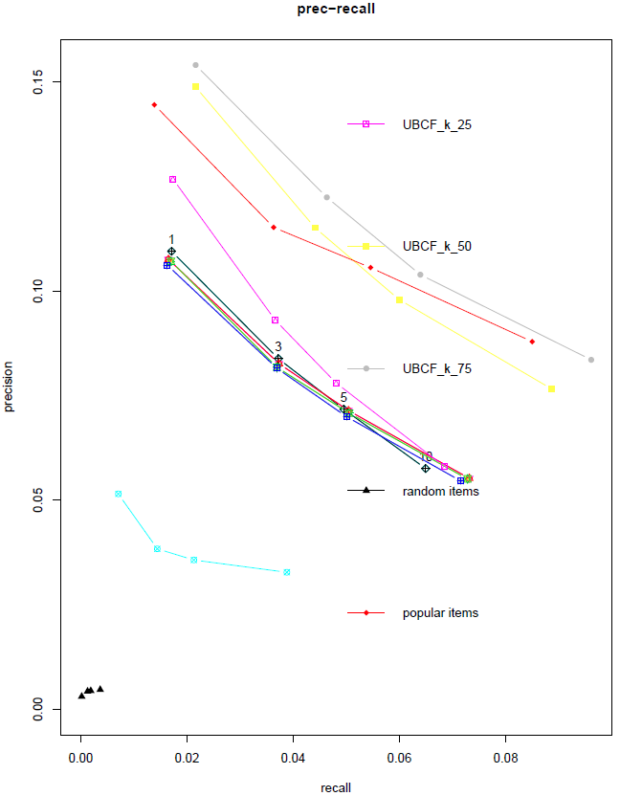
grid search to optimize parameters

Slide 20
Big data
In most real world scenarios recommenders will have data too large to analyze on a local machine.
Way to get around…
Incremental – use small program and database to loop through and generates counts of all products uploading in database as you go…
More ad-hoc
Use big data tools!!!
Spark
Mahout
Neo4j
etc

